Slide 1


Hands-on Biological Data Science with R
Getting started: Installing R and RStudio

Slide 2

What is R?
R is an open-source statistical programming language that was created in the 1990’s specifically for data analysis.
We will start by installing R and RStudio, which is an integrated development environment, or IDE for R programming. There are other IDE’s available for R but we strongly suggest RStudio since it is the most common one with lots of help available online navigating it for beginners.

Slide 3
Download and Install on a Mac
Step 1: Navigate to the Comprehensive R Archive Network (CRAN), which is located at https://cran.r-project.org/.
Step 2: Click on Download R for (Mac) OS X.
Step 3: Click on the link for the latest version of R (”Latest release”). After clicking the link, R should start to download to your computer automatically.
Step 5: Locate the package file you just downloaded and double click it. Unless you have changed your download settings, this file will probably be in your “downloads” folder. That is the default location for most web browsers. After you locate the file, just double click it.
Step 6: A dialogue box will open and ask you to make some decisions about how and where you want to install R on your computer.
Step 7: Navigate to the RStudio desktop download website, which is located at https://rstudio.com/products/rstudio/download/. On that page, click the download button under RStudio Desktop Open Source License Free.
Step 8: Download the most current version for Mac.
Step 9: Again, locate the dmg file you just downloaded and double click it. Unless you’ve changed your download settings, this file should be in the same location as the R package file you already downloaded.
Step 10: A new finder window should automatically pop up. Click on the RStudio icon and drag it into the Applications folder.
Step 11: To start Rstudio click on the new application icon.

Slide 4
Download and Install on a PC
Step 1: Navigate to the Comprehensive R Archive Network (CRAN), which is located at https://cran.r-project.org/.
Step 2: Click on Download R for Windows. Click on the base link.
Step 3: Click on the link for the latest version of R (”Latest release”). After clicking the link, R should start to download to your computer automatically.
Step 5: Locate the package file you just downloaded and double click it. Unless you have changed your download settings, this file will probably be in your “downloads” folder. That is the default location for most web browsers. After you locate the file, just double click it.
Step 6: A dialogue box will open and ask you to make some decisions about how and where you want to install R on your computer.
Step 7: Navigate to the RStudio desktop download website, which is located at https://rstudio.com/products/rstudio/download/. On that page, click the download button under RStudio Desktop Open Source License Free.
Step 8: Download the most current version for Windows.
Step 9: Again, locate the installation file you just downloaded and double click it. Unless you’ve changed your download settings, this file should be in the same location as the R package file you already downloaded.
Step 10: Another dialogue box will open and ask you to make some decisions about how and where you want to install RStudio on your computer.
Step 11: When RStudio is finished installing, you should see RStudio in the Windows start menu. Click the icon to open RStudio.

Slide 5
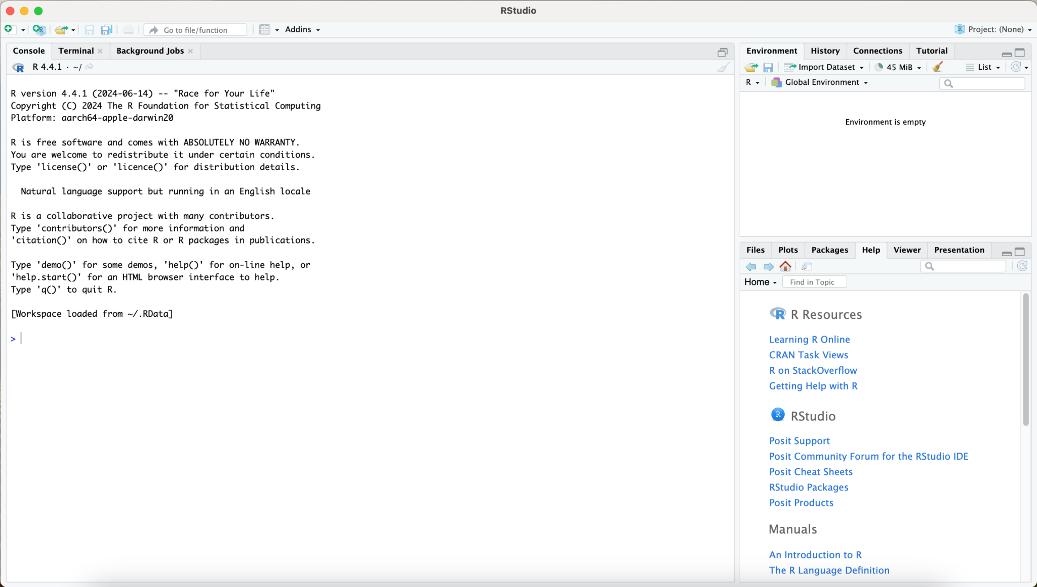
R Studio
If you see this when you open RStudio then you’re ready to go!

Slide 6
References
Cannell B, Livingston M. R for Epidemiology. Chapter 1 Installing R and RStudio.

Slide 7
Thanks for your attention!
Contacts:
Ekin Yaman Dr. med. Sarah Kim-Hellmuth
✉: Ekin.Yaman@med.uni-muenchen.de https://www.ccrc-hauner.de/kim-hellmuth-labor
Dr. med. Paula Rothämel
✉: Paula.Rothaemel@med.uni-muenchen.de

